Slide 1

Ch.06
Object Oriented Programming
Siva R Jasthi
ICS325 – Internet Application Development
Information and Computer Sciences
Metropolitan State University

Slide 2
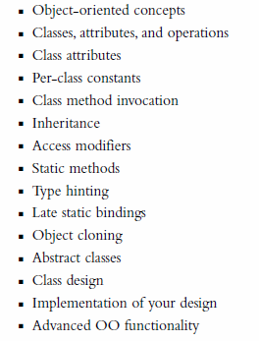
Outline
Many of the concepts are similar to Java.
If you know Java OOP, you know PHP OOP.
There are a couple of syntax differences we need to be conscious of in PHP.

Slide 3
OO Terminology
Classes
Objects
Polymorphism
Inheritance
Creating an instance
Access Permissions (private, public, protected, package)
Overriding
Final keyword
Interfaces
Abstract Classes
Instanceof operator (checking classtype and Type Hinting)

Slide 4
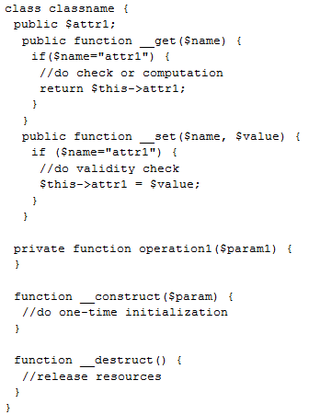
Class Structure
Accessor/
Getter
Attribute
Instantiate a class:
$a = new classname();
$a->attr1= "value";
$a->operation1();
Mutator/Setter
Accessors/Mutators:
Operation
Constructor
Access Modifiers
public (default): from in/out of class
private: only from in class – not inherited
protected: only from in class - inherited
Destructor

Slide 5
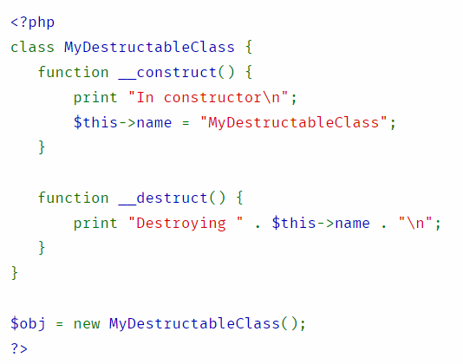
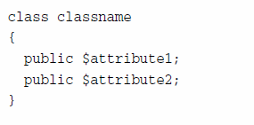
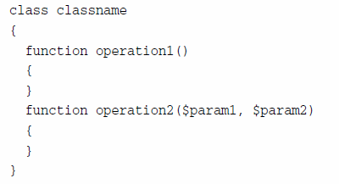
Constructor, destructor

Slide 6
Accessing instance methods and variables
In Java, you use . (dot) operator
In PHP, you use → reference operator

Slide 7
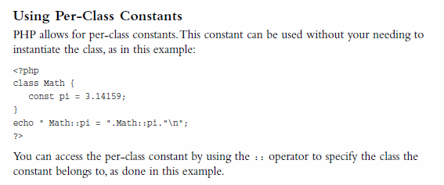
Per-Class Constants
In PHP, the scope resolution operator is also called Paamayim Nekudotayim (Hebrew) which means “double colon” in Hebrew.
In Java, you use “static” key word before the variable

Slide 8
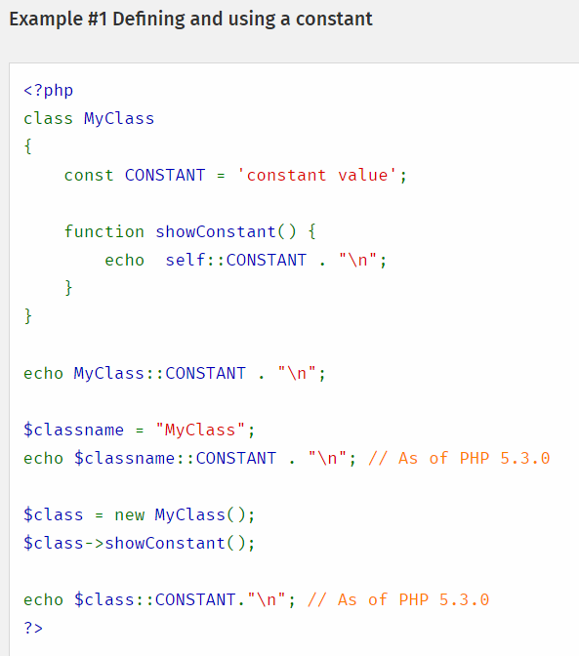

Slide 9
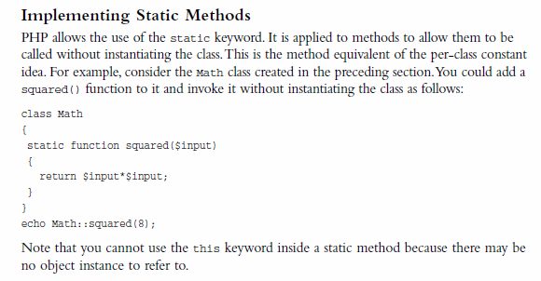
Implementing Static Methods
Similar to static / constants in PHP
You use double colon :: to invoke static methods

Slide 10
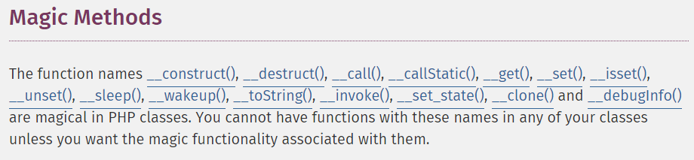
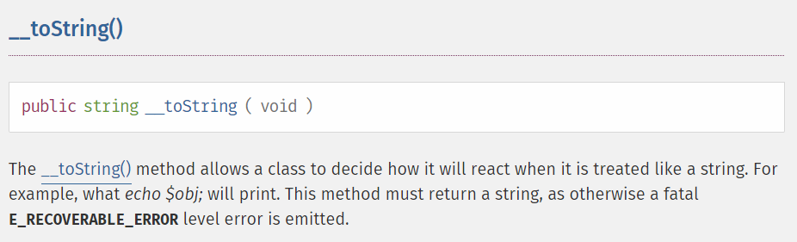
Magic methods and toString() method

Slide 11
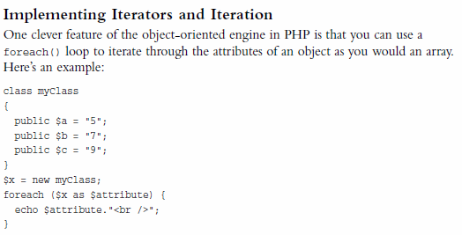
Implementing Iterators and Iteration object

Slide 12
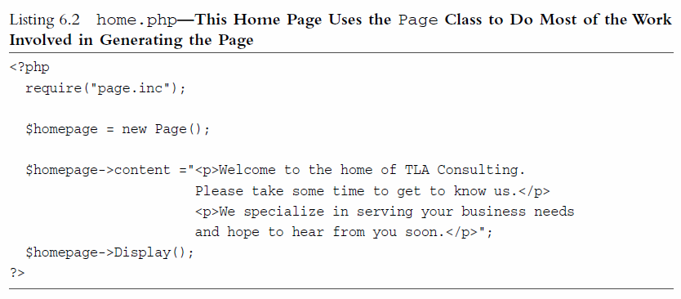
Examples (from Chapter 06)
Try home.php
Try services.php
page class
definition
Reuses page
to display
Reuses page
to display

Slide 13
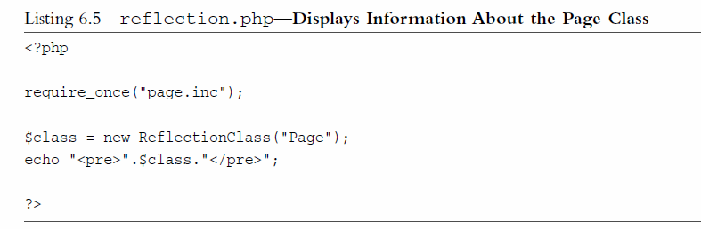
PHP supports Reflection
Reflection is the ability to interrogate existing classes and objects to find out about their structure and content.
This capability will be useful to know more about the classes (especially unknown or undocumented classes).
Try reflection.php

Slide 14
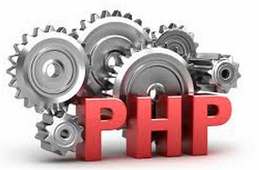
Summary
OO concepts are exactly same irrespective of the language (PHP or Java).
The syntax is also similar between PHP and Java in majority of the cases.
A couple of notable exceptions are:
In PHP, you use . (dot) Operator to combine strings
In PHP, you use :: (double colon) operator to access the constants and static methods
In PHP, you use → (reference operator) to access instance variables and methods

